Slide 1

Tower Defense Game C++ & GLUT
By Martyn van Dijke
Computation II

Slide 2
Second year Electrical Engineering student
Program experience:
Python (2.7)
SQL
HTML
C ( Computation I )
Arduino
Linux
Raspberry Pi
About me

Slide 3
Contents of the Presentation
Game overview
Library includes
Classes used
Additional features that have been implemented
Improvements that can be made
Conclusion
Questions
Demonstration of the game
Contents

Slide 4
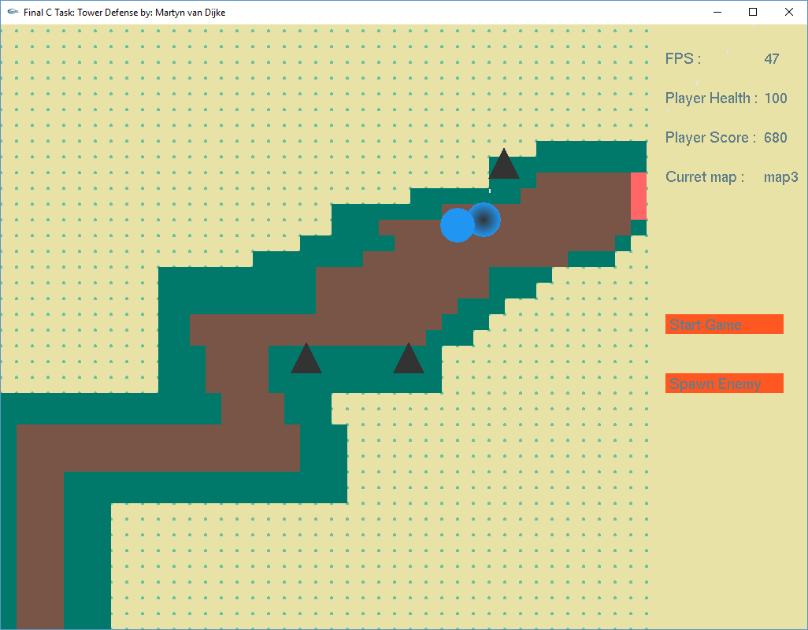
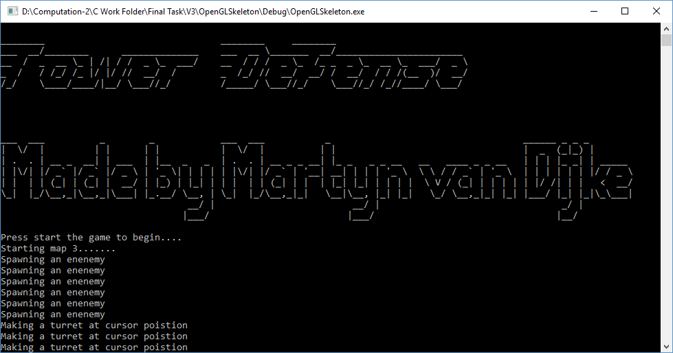
Basic
Turret aiming
Enemy movement
Map data where to build & walk
GUI
Debug & control
Overview of the game

Slide 5
Number
Statictics

Slide 6
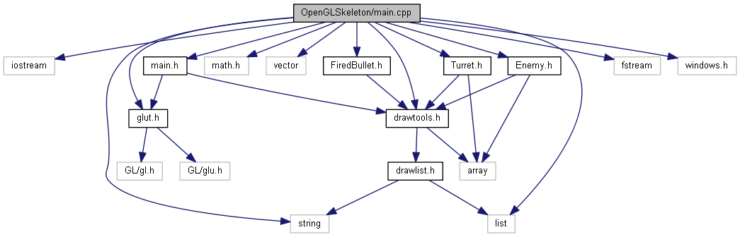
Important library includes
Vector use instead of (linked) list
Mat library for calculating (mostly circles and intersection points)
Fstream and iostream for file (map) access
Windows for waiting
Library includes

Slide 7
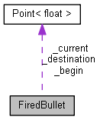
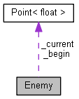
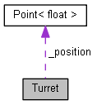
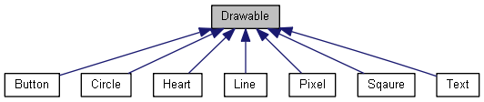
Classes
FiredBullet
Enemy
Turret
Drawable:
Button
Circle
Heart (future)
Line
Square
Text
Features

Slide 8
Extra features
Sound effects
Multiple maps
Button’s
Mouse input
Keyboard input
GLUT window input
Frame per second calculation
Additional features

Slide 9
Improvements that can be made
Aim algorithm
More predictive aiming
Walk algorithm
Implement A*
Improvements to be made

Slide 10

Conclusion
Fun to program C++
C++ is great programming langue
C++ is very extensible and fast
C++ & GLUT can be cumbersome
Conclude

Slide 11

Are there any questions ?
Questions

Slide 12
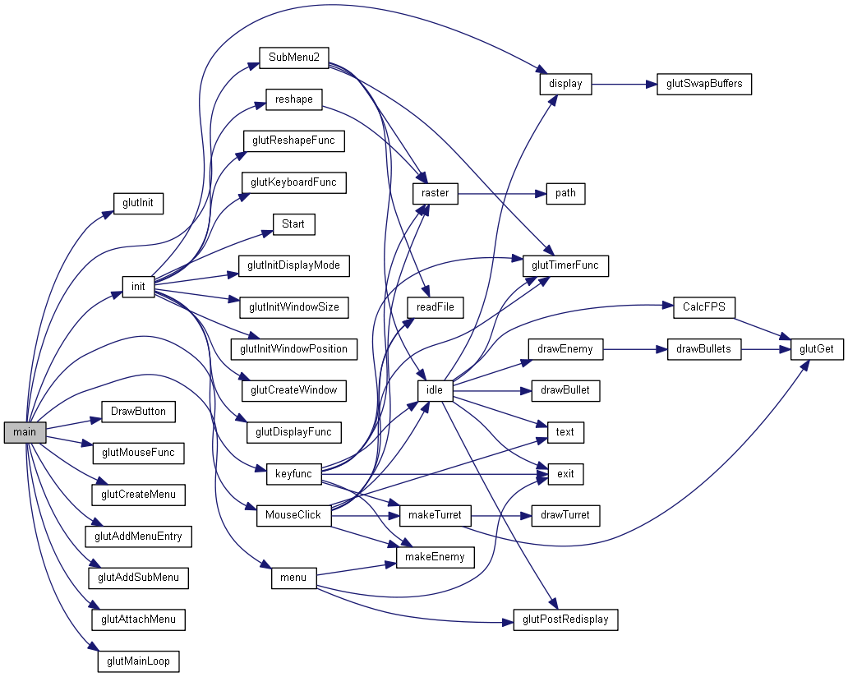
Overview of the
Main code :
Overview Code I Main
Notes:
In order to explain this mess of networks a look is made in the init function and the keyboard function along with the nececarry stops into classes etc

Slide 13
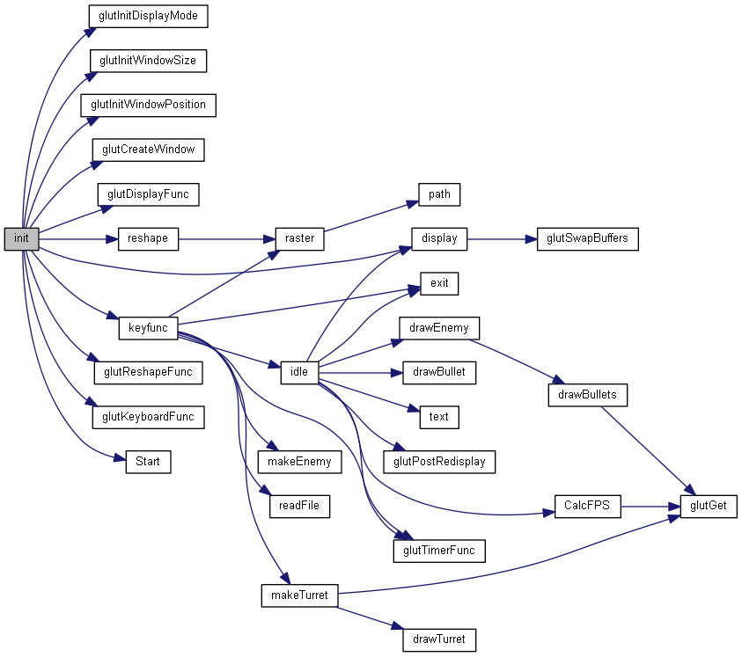
Init()

Slide 14
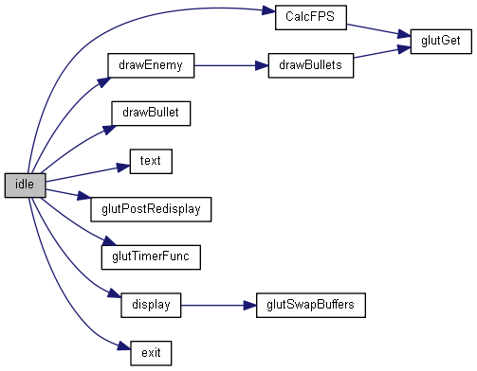
Idle()
Overview || Important functions

Slide 15
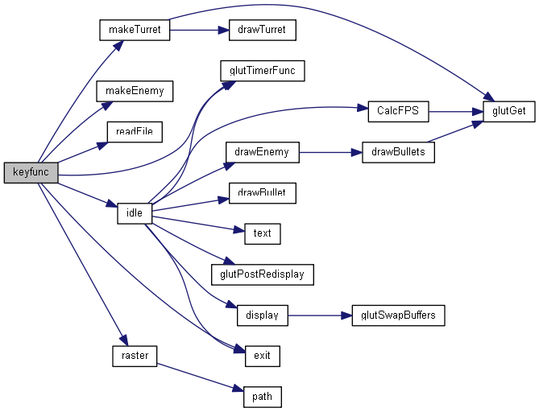
Keyfunc()

Slide 16
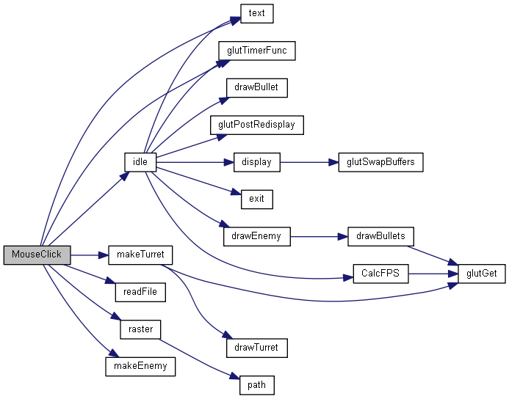
MouseClick()

Slide 17
Demo
Demo

